Slide 1
Introduction
and
Operating System Structure

Slide 2
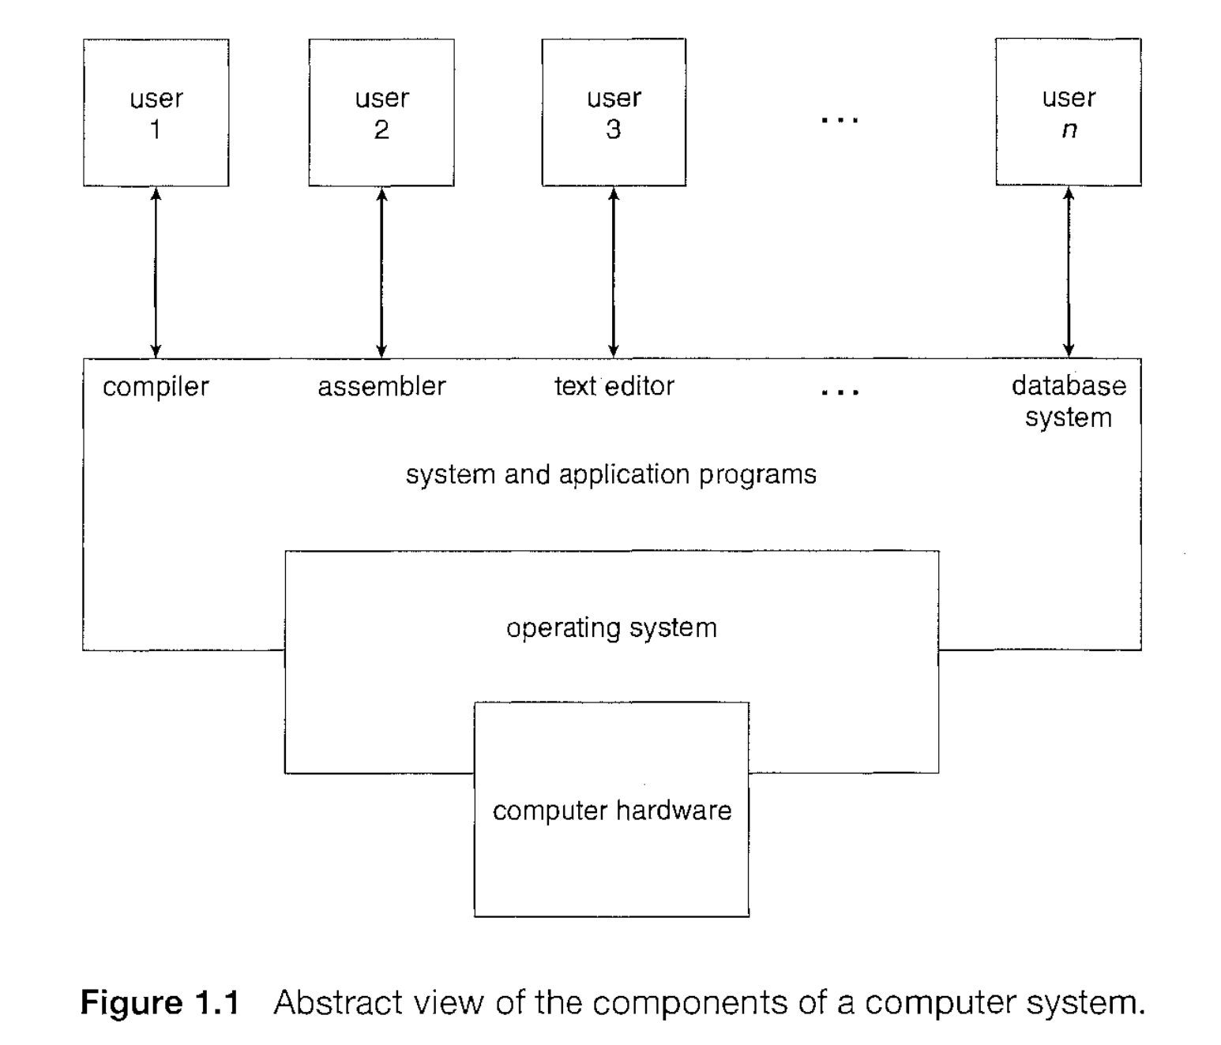
User View
System View
Notes:
User view and system view

Slide 3
operating system is the one program running at all times on the computer-usually called the kernel.
Along with the kernel, there are two other types of programs: system program, which are associated with the operating system but are not part of the kernel
application program, which include all programs not associated with the operation of the system.)

Slide 4
For a computer to start running for instance, when it is powered up or rebooted - it needs to have an initial program to run. This initial program, or bootstrap program, tends to be simple.
Typically, it is stored in read-only memory (ROM) or electrically erasable programmable read-only memory (EEPROM), known by the general term firmware, within the computer hardware.
It initializes all aspects of the system, from CPU registers to device controllers to memory contents. The bootstrap program must know how to load the operating system and how to start executing that system.
To accomplish this goal, the bootstrap program must locate and load into memory the operating system kernel. The operating system then starts executing the first process, such as "init," and waits for some event to occur.

Slide 5
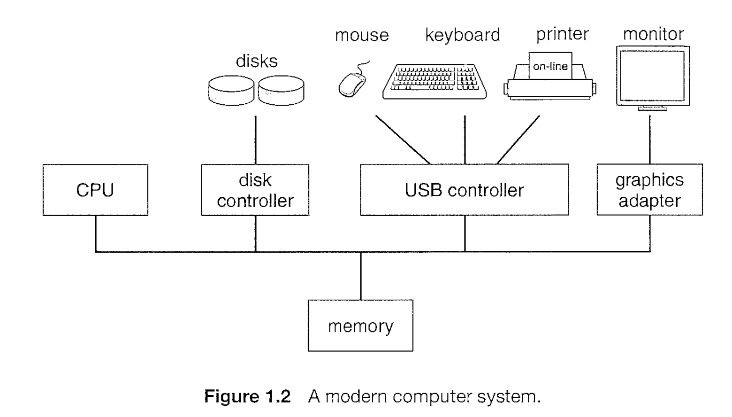

Slide 6
The CPU can load instructions only from memory, so any programs to run must be stored there.
General-purpose computers run most of their programs from rewriteable memory, called main memory (also called random access memory - RAM)
Main memory commonly is implemented in a semiconductor technology called dynamic random access memory (DRAM).
the read-only memory (ROM) can not be changed, only static programs are stored there.

Slide 7
A typical instruction-execution cycle, as executed on a system with a Von Neumann architecture,
first fetches an instruction from memory and stores that instruction in the instruction register.
The instruction is then decoded and may cause operands to be fetched from memory and stored in some internal register.
After the instruction on the operands has been executed, the result may be stored back in memory.

Slide 8
Ideally, we want the programs and data to reside in main memory permanently. This arrangement usually is not possible for the following two reasons:
Main memory is usually too small to store all needed programs and data permanently.
Main memory is a volatile storage device that loses its contents when power is turned off or otherwise lost.

Slide 9
Thus, most computer systems provide secondary storage as an extension of main memory. The main requirement for secondary storage is that it be able to hold large quantities of data permanently.
The most common secondary-storage device is a magnetic disk, which provides storage for both programs and data. Most programs (system and application) are stored on a disk until they are loaded into memory.

Slide 10
In a larger sense, however, the storage structure that we have described, consisting of registers, main memory, and magnetic disks, is only one of many possible storage systems. Others include cache memory, CD-ROM, magnetic tapes, and so on.
The main differences among the various storage systems lie in speed, cost, size, and volatility.

Slide 11
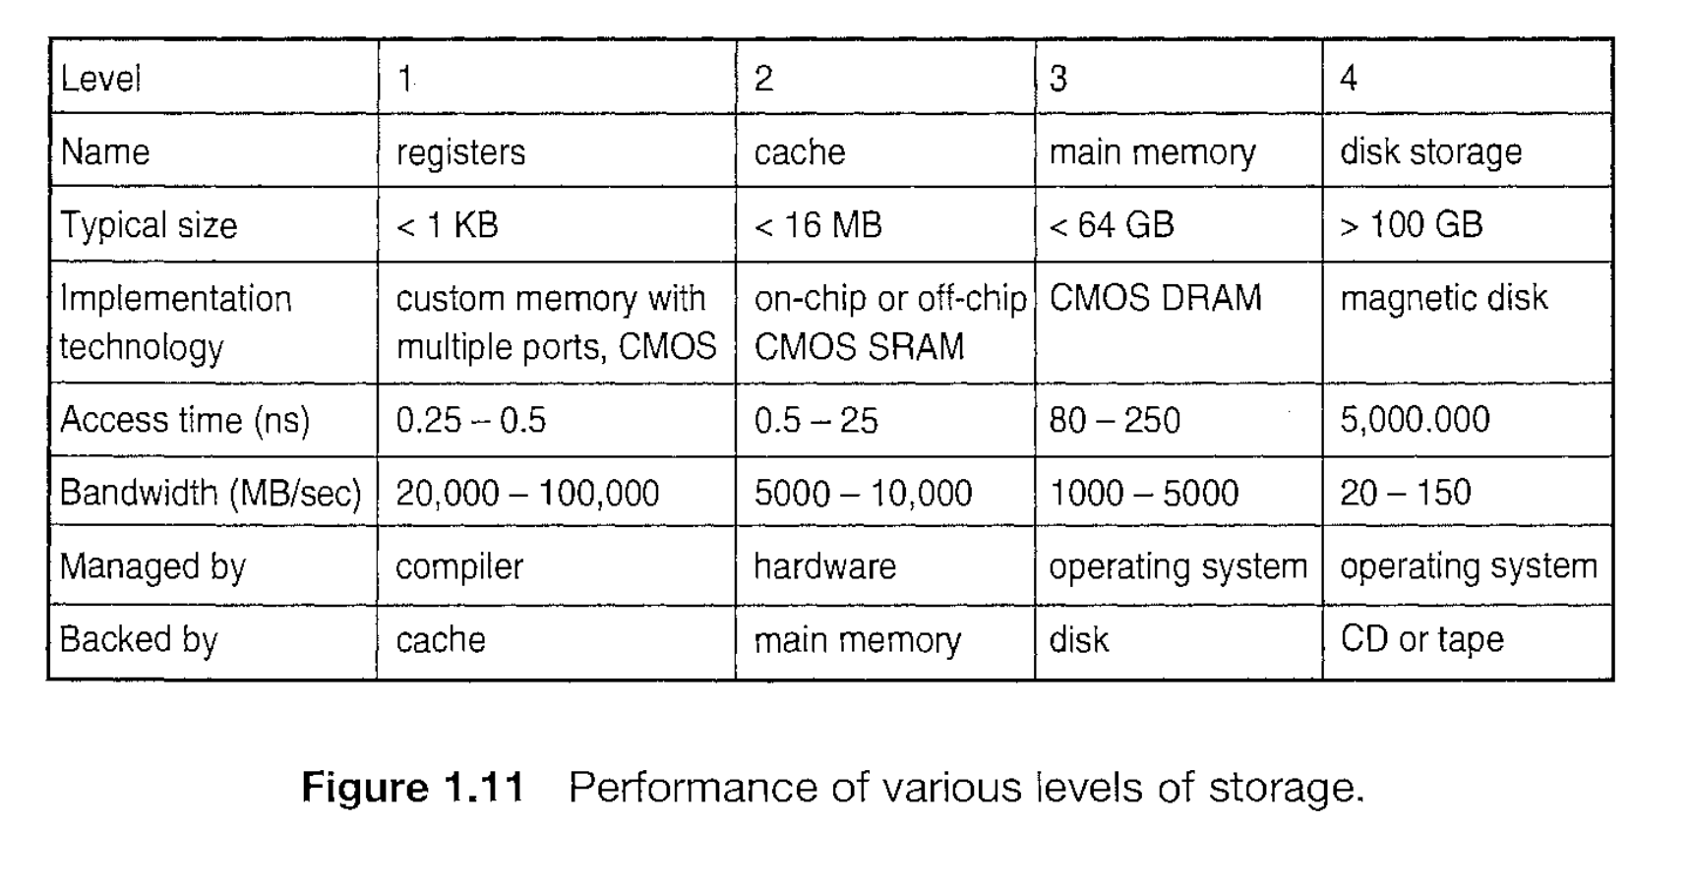

Slide 12
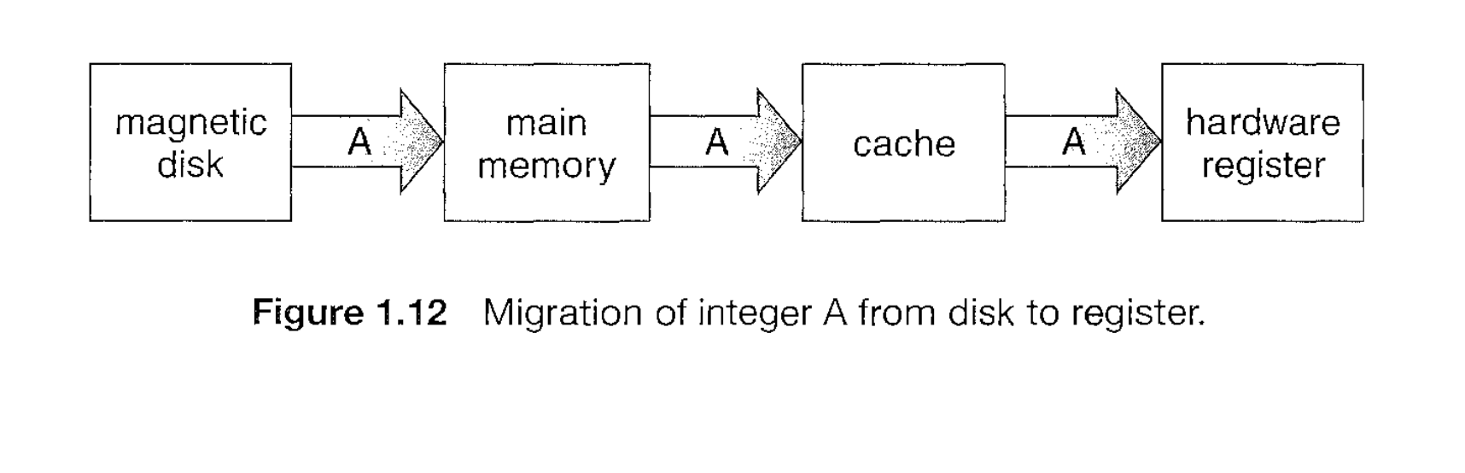

Slide 13
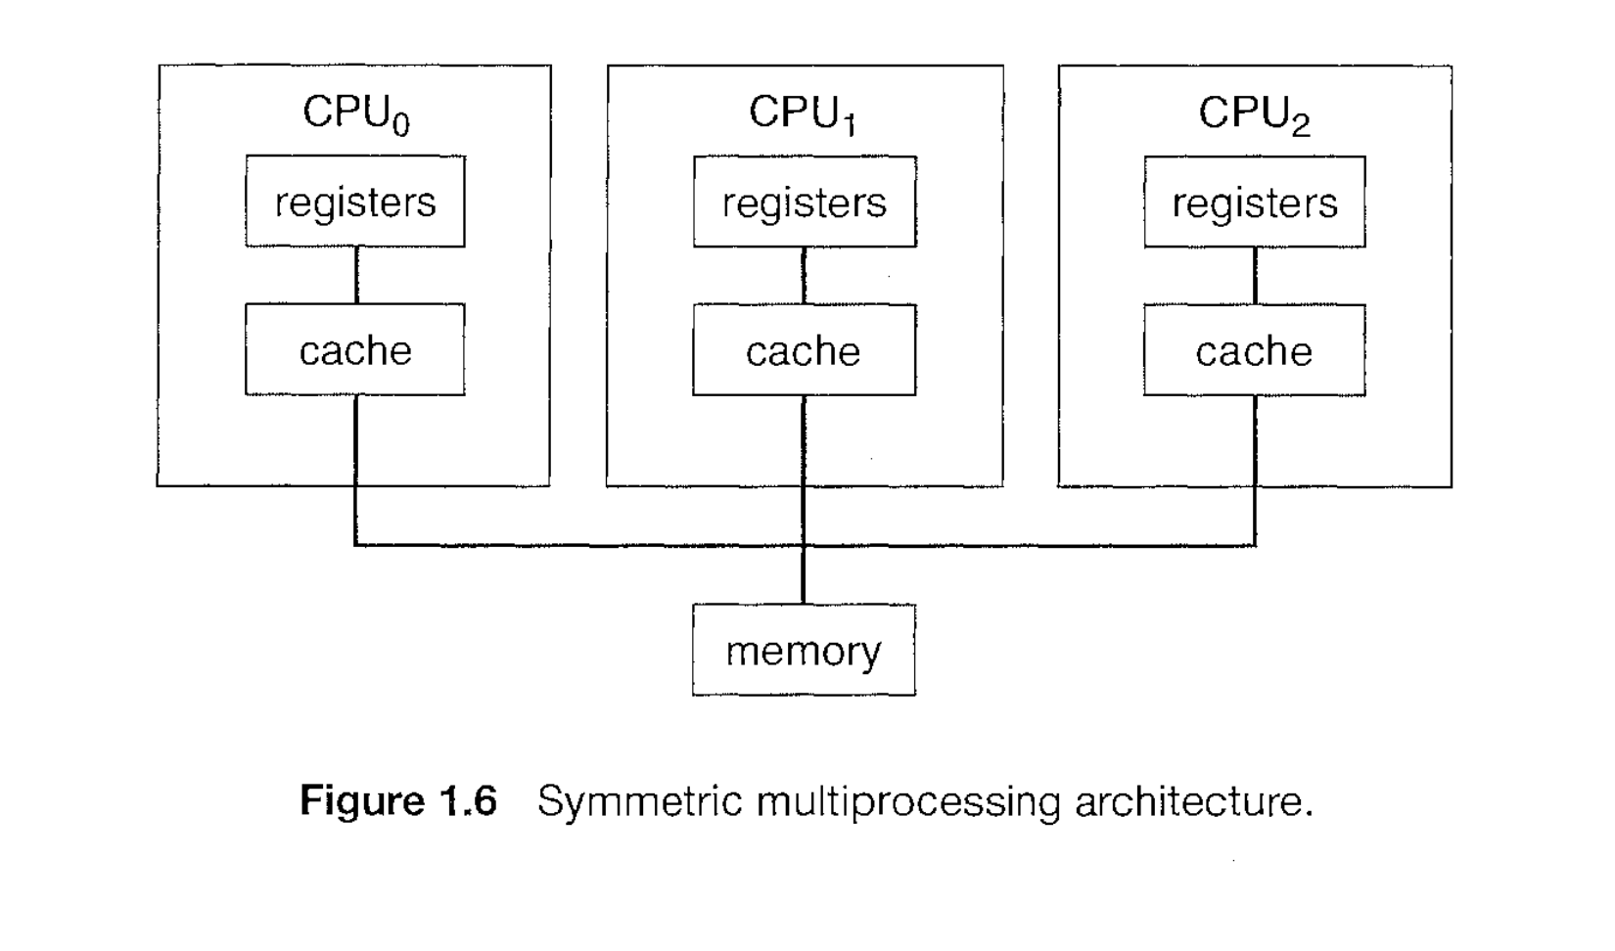

Slide 14
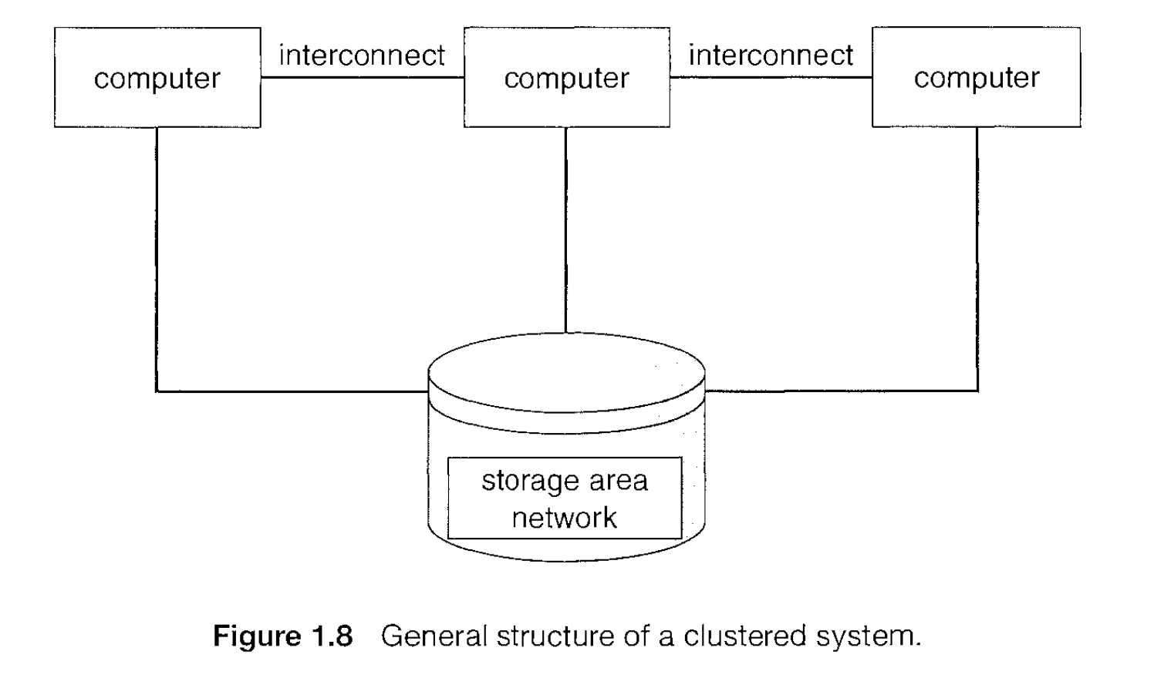

Slide 15
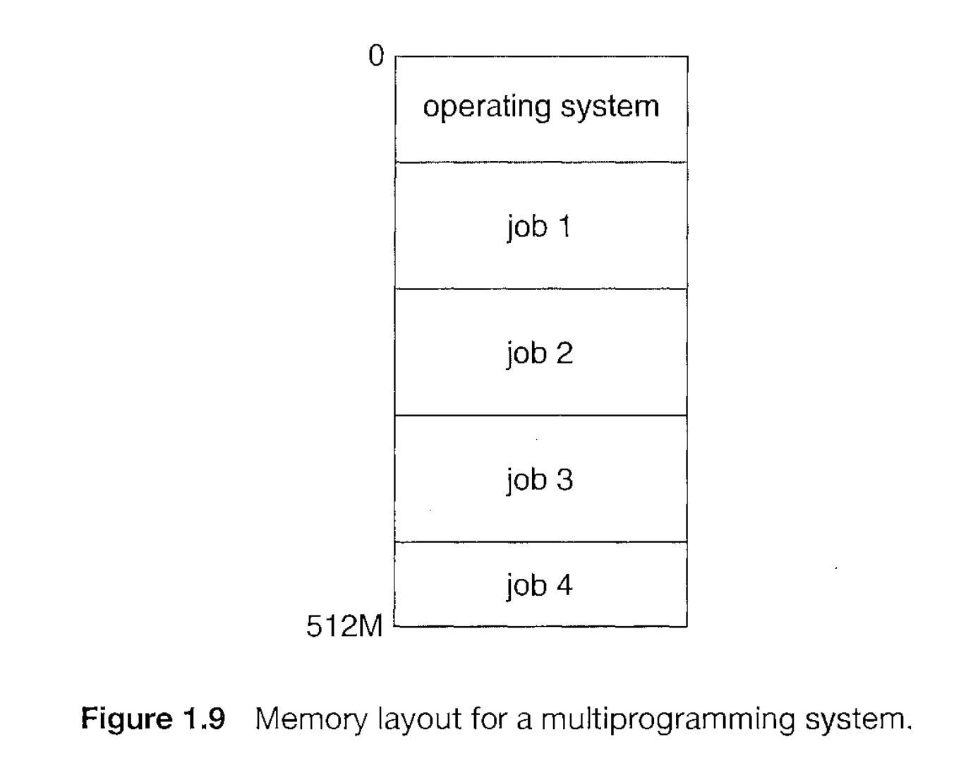
Notes:
Process: execution unit of instruction

Slide 16
A program loaded into memory and executing is called a process.
When a process executes, it typically executes for only a short time before it either finishes or needs to perform I/0.
Since interactive I/0 typically runs at "people speeds," it may take a long time to complete. Input, for example, may be bounded by the user's typing speed; seven characters per second is fast for people but incredibly slow for computers. Rather than let the CPU sit idle as this interactive input takes place, the operating system will rapidly switch the CPU to the program of some other user.

Slide 17
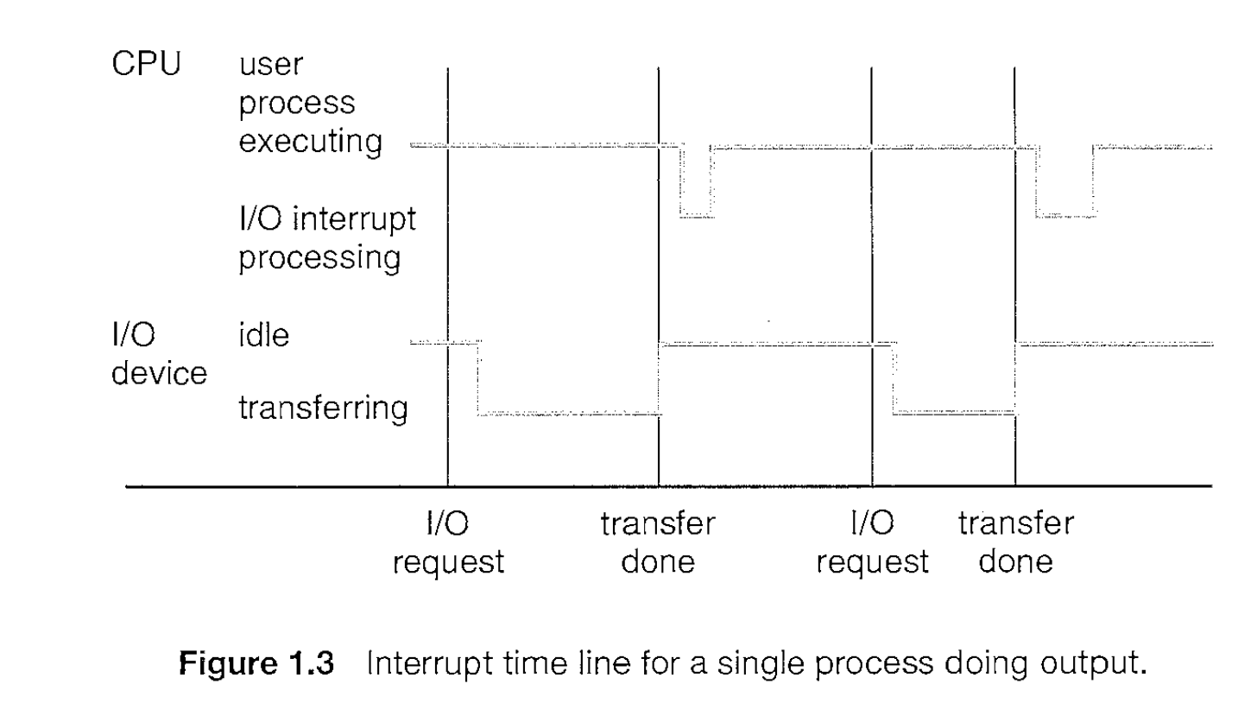
The interrupt-driven nature of an operating system defines that system's general structure
The occurrence of an event is usually signaled by an interrupt from either the hardware or the software.
Hardware may trigger an interrupt at any time by sending a signal to the CPU, usually by way of the system bus.
Software may trigger an interrupt executing a special operation called a system call (or monitor call).

Slide 18
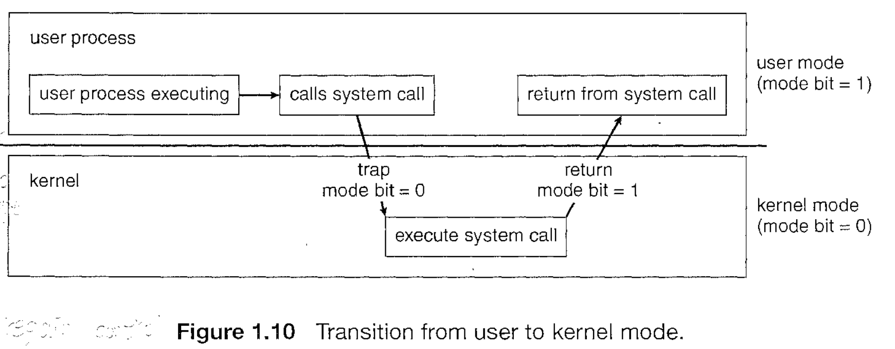
Dual-Mode Operation

Slide 19
process management
Scheduling processes and threads on the CPUs
Creating and deleting both user and system processes
Suspending and resuming processes
Providing mechanisms for process synchronization
Providing mechanisms for process communication

Slide 20
memory management
Keeping track of which parts of memory are currently being used and by whom
Deciding which processes (or parts thereof) and data to move into and out of memory
Allocating and deallocating memory space as needed

Slide 21
Storage management
Creating and deleting files
Creating and deleting directories to organize files
Supporting primitives for manipulating files and directories
Mapping files onto secondary storage
Backing up files on stable (nonvolatile) storage media

Slide 22
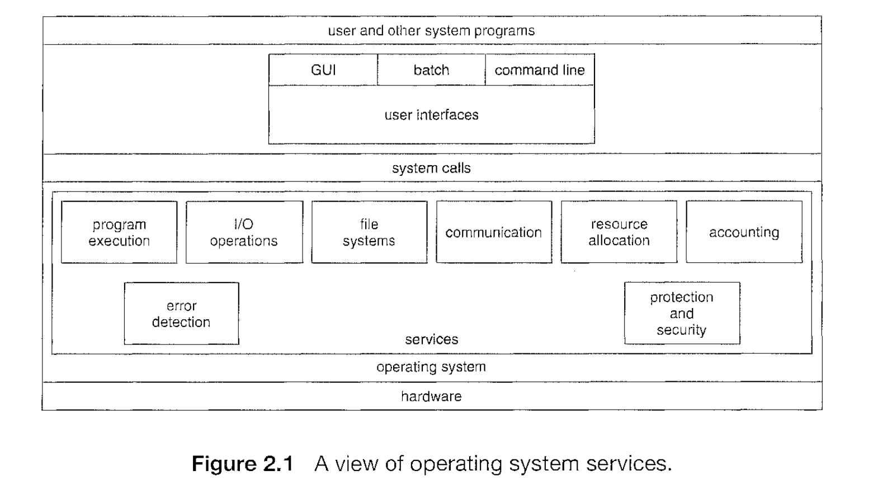

Slide 23
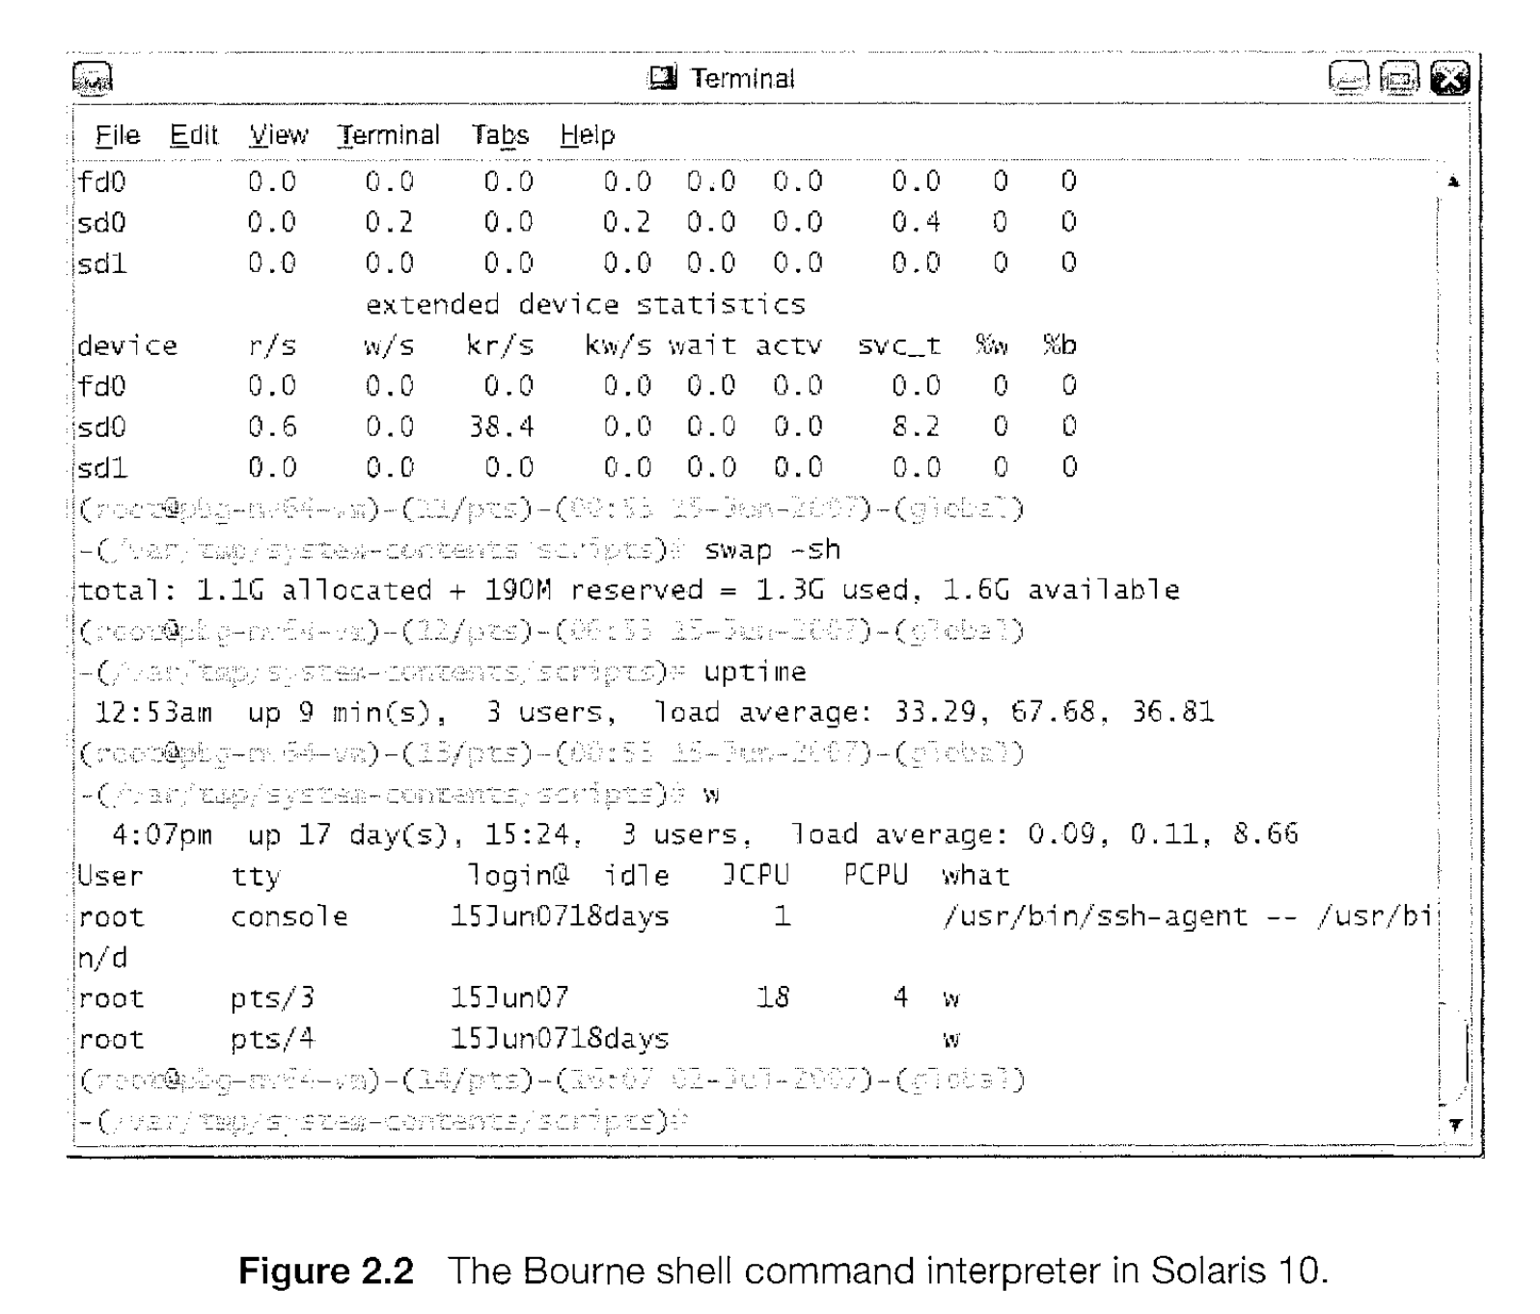

Slide 24
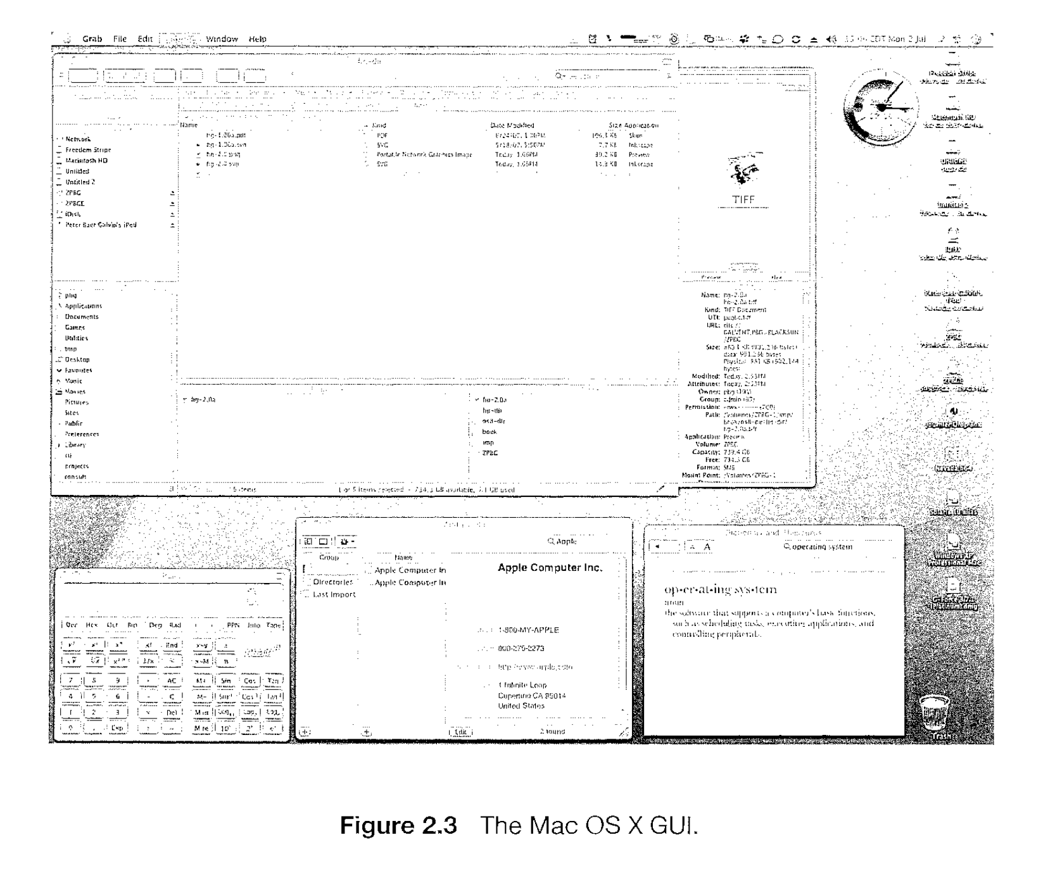

Slide 25
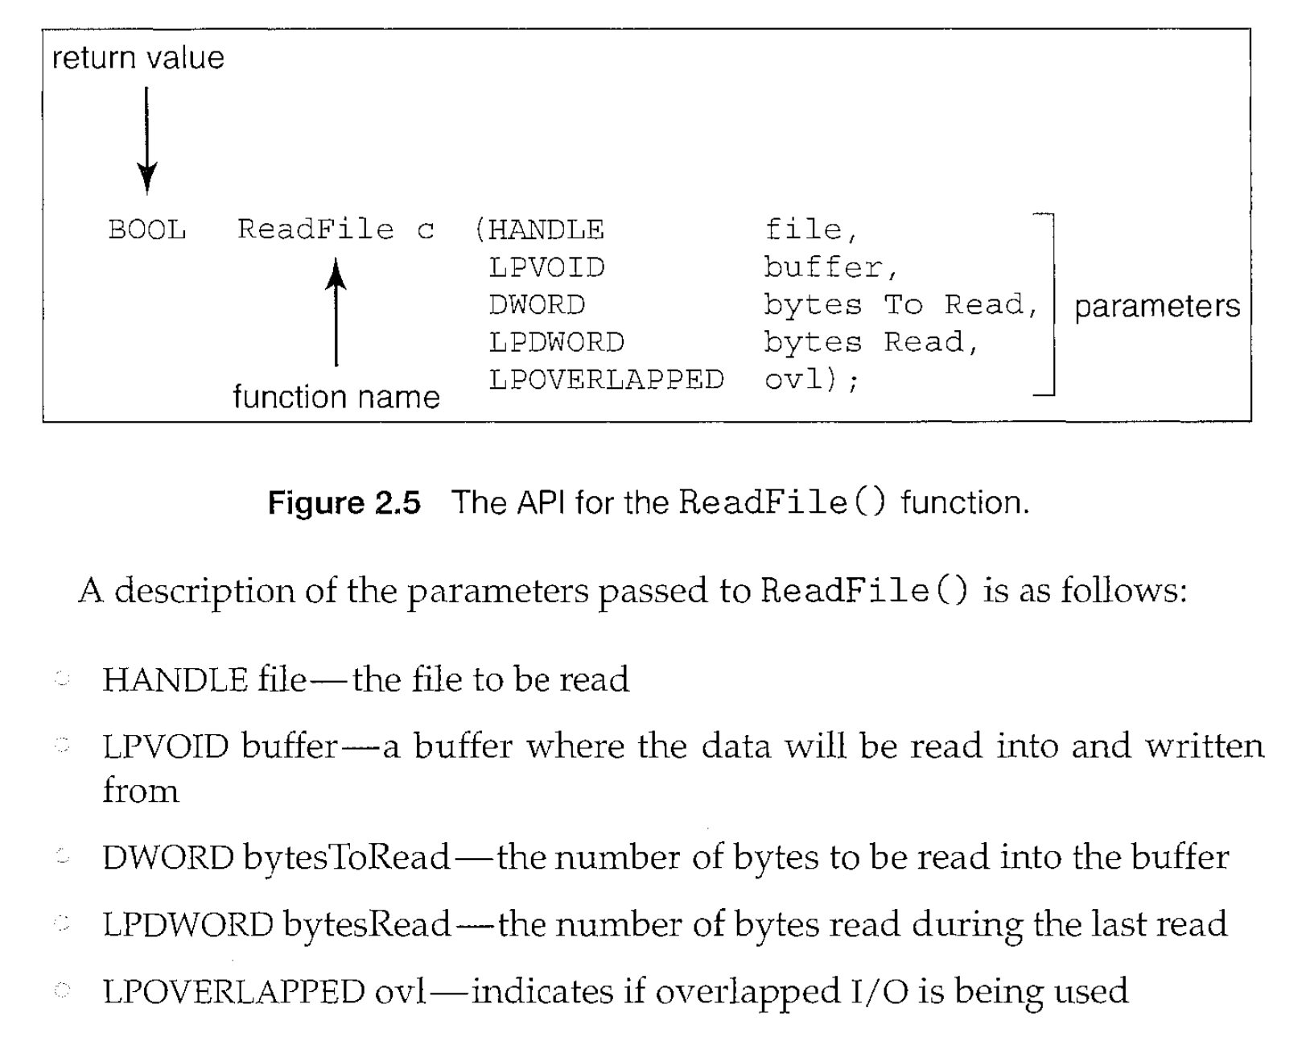

Slide 26
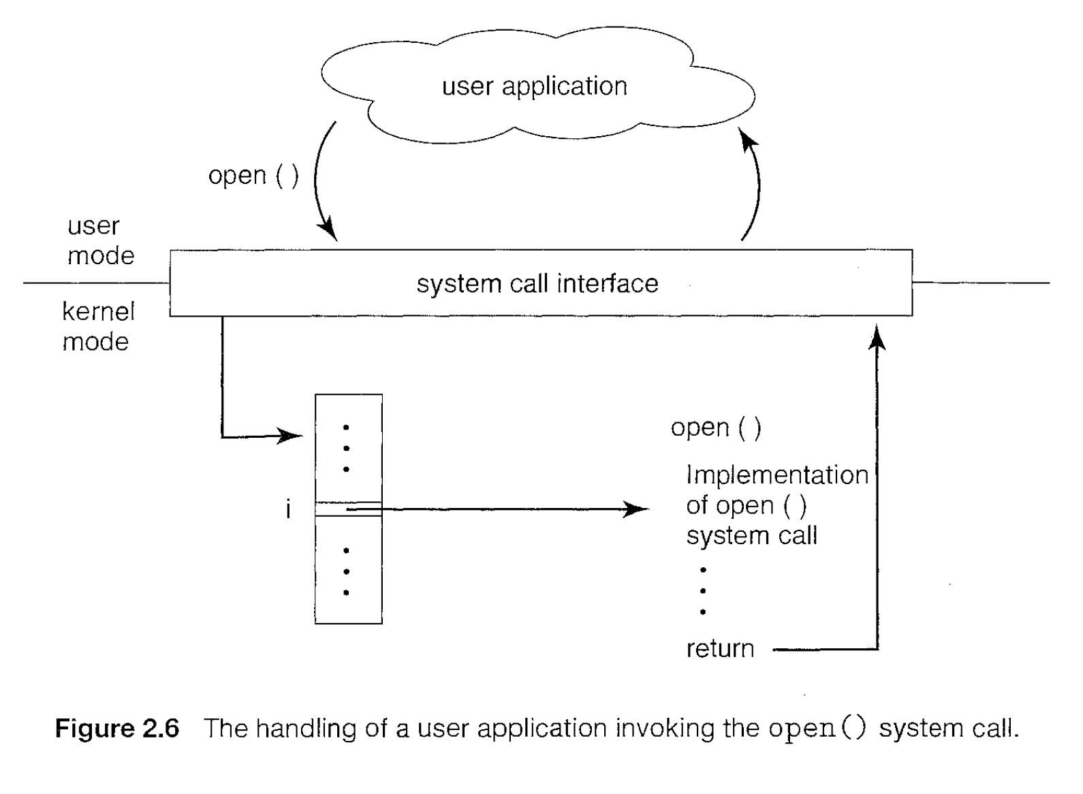
System call: an interface to the services made available by an operating system.

Slide 27
Types of System Call: Process Control
end, abort
load, execute
create process, terminate process
get process attributes, set process attributes
wait for time
wait event, signal event
allocate and free memory
Example
  Windows: CreateProcess(), ExitProcess (), WaitForSingleObject()
  Unix: fork(), exit(), wait()

Slide 28
Types of System Call: File management
create file, delete file
open, close
read, write, reposition
get file attributes, set file attributes
Example:
  Windows: CreateFile(), ReadFile(), WriteFile (), CloseHandle ()
  Unix: open() , read() , write() , close()

Slide 29
Types of System Call: Device management
request device, release device
read, write, reposition
get device attributes, set device attributes
logically attach or detach devices
Example
  Windows: SetConsoleMode(), ReadConsole(), WriteConsole()
  Unix: read(), write()

Slide 30
Types of System Call: Information maintenance
get time or date, set time or date
get system data, set system data
get process, file, or device attributes
set process, file, or device attributes
Example
  Windows: GetCurrentProcessiD(), SetTimer(), Sleep()
  Unix: getpid(), alarm(), sleep()

Slide 31
Types of System Call: Communications
create, delete communication connection
send, receive messages
transfer status information
attach or detach remote devices
Example:
  Windows: CreatePipe (), CreateFileMapping(), MapViewOfFile ()
  Unix: pipe(), shmget(), mmap()

Slide 32
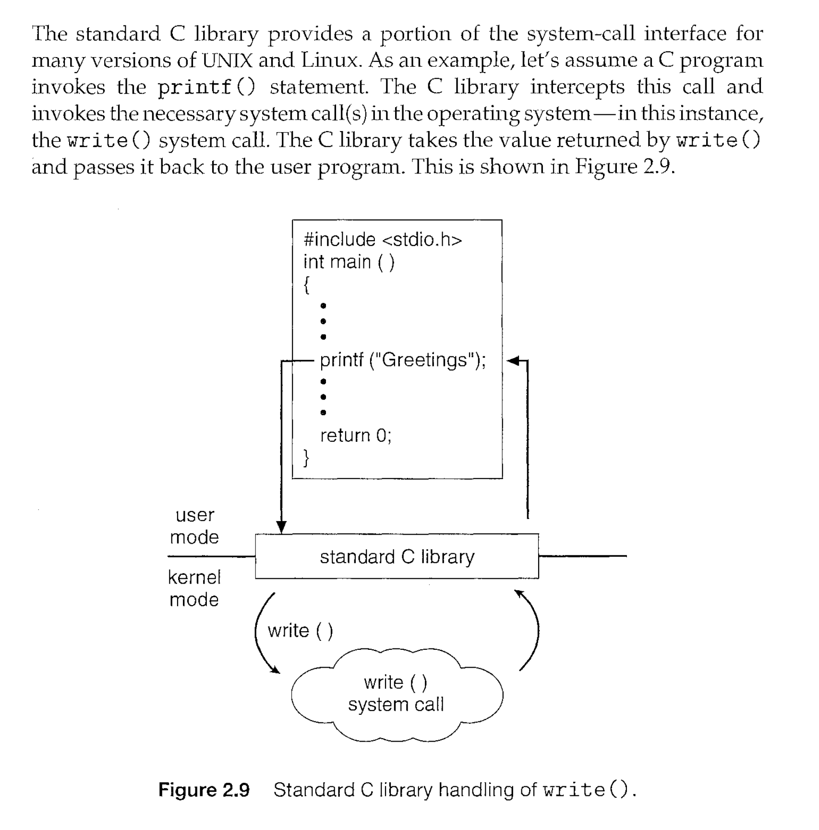

Slide 33
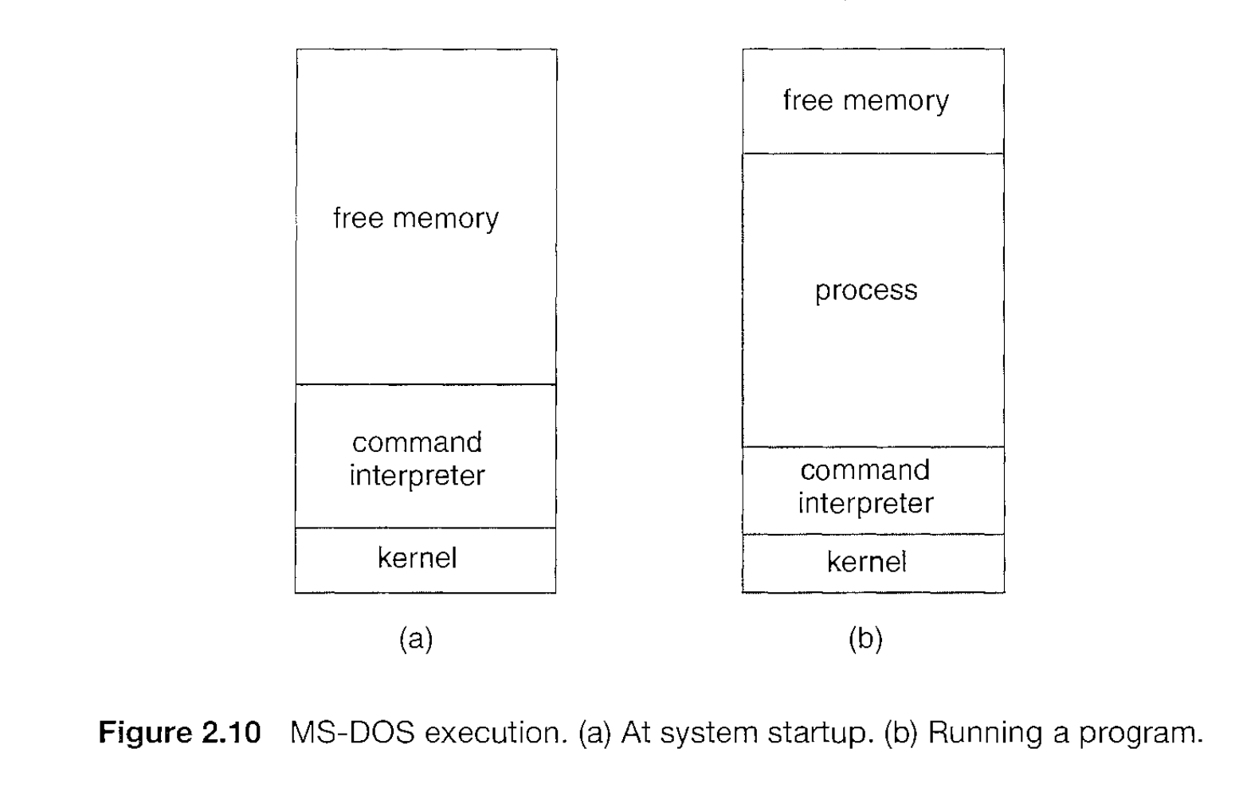

Slide 34
Operating System Structure
Simple
Layered Approach
Microkernels
Modules

Slide 35
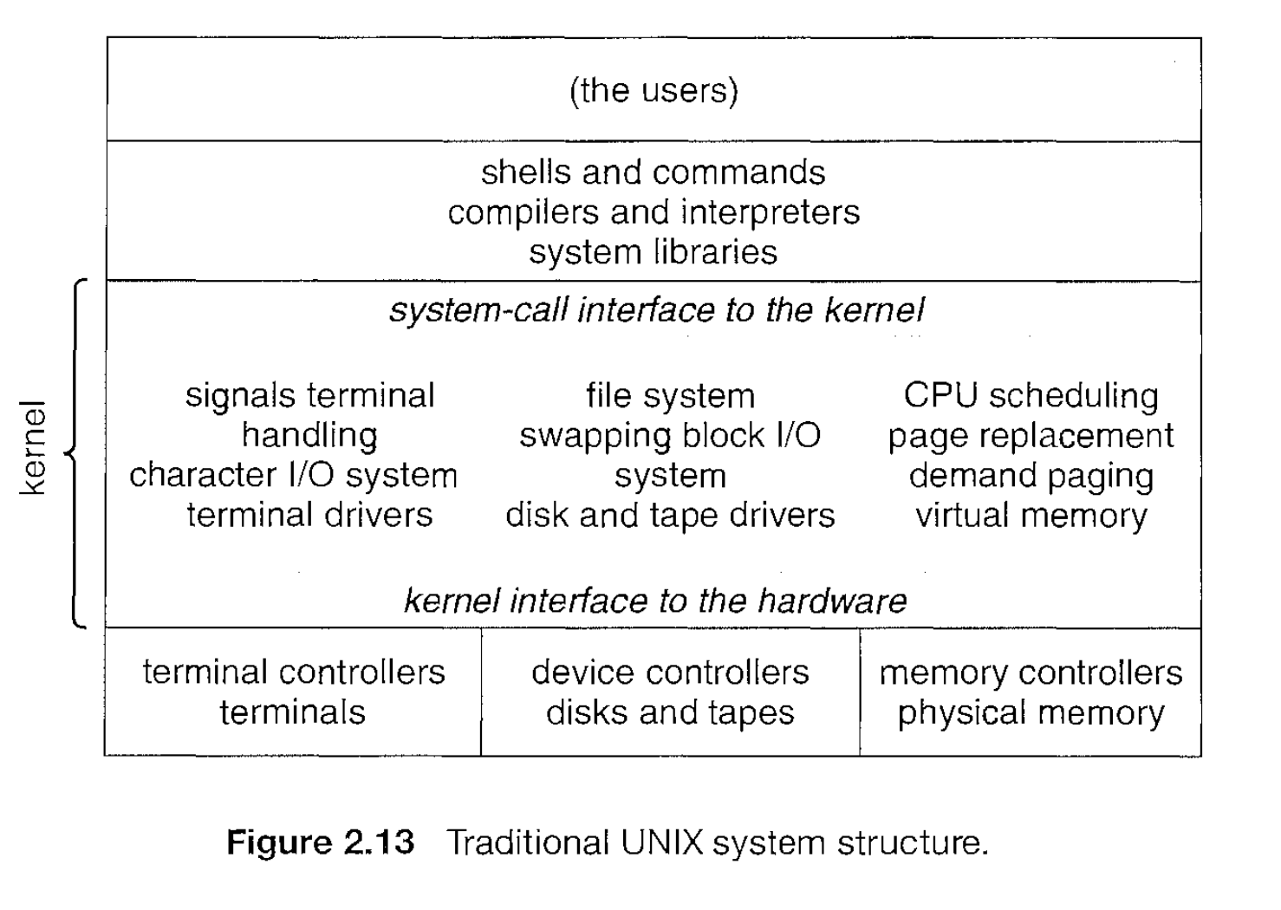
Simple Structure

Slide 36
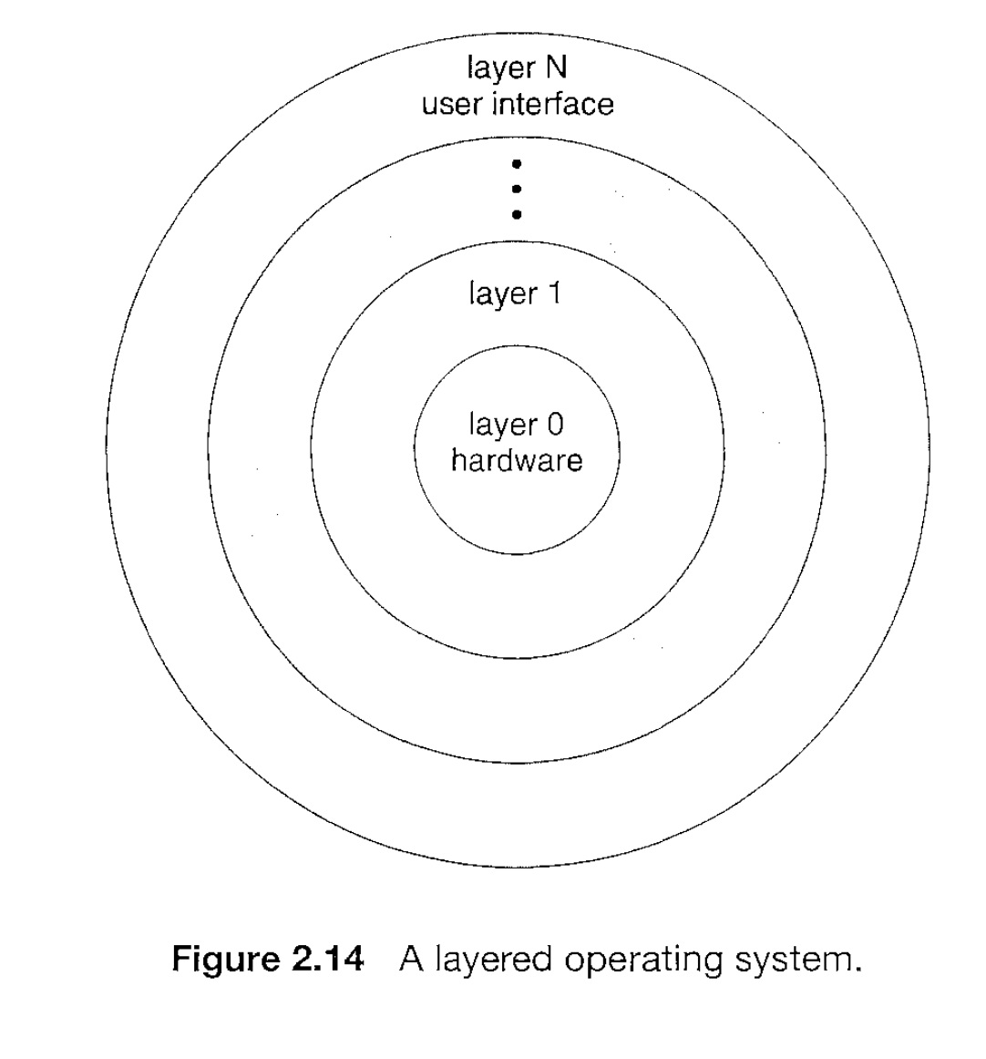
Layered Approach

Slide 37
Microkernels
This method structure the operating system by removing all necessary component from kernel and implementing them as system and user level programs
The main function of the micro kernel is to provide a communication facility between the client program and the various services that are also running in user space.
One benefit of the microkernel approach is ease of extending the operating system. The resulting operating system is easier to port from one hardware design to another.
The microkernel also provides more security and reliability, since most services are running as user-rather than kernel-processes.

Slide 38
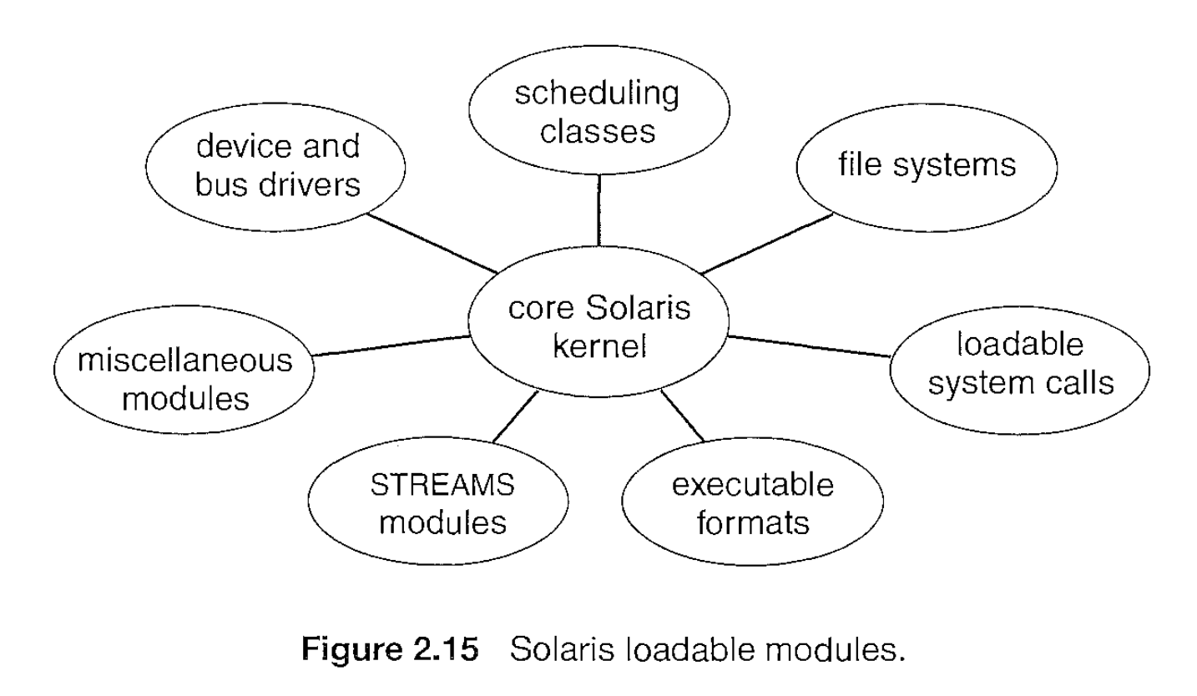
Modules

Slide 39
Virtual Machines
The layered approach is taken to its logical conclusion in the concept of a Virtual Machine. The fundamental idea behind a virtual machine is to abstract the hardware of a single computer (the CPU, memory, disk drives, network interface cards, and so forth) into several different execution environments, thereby creating the illusion that each separate execution environment is running its own private computer.

Slide 40
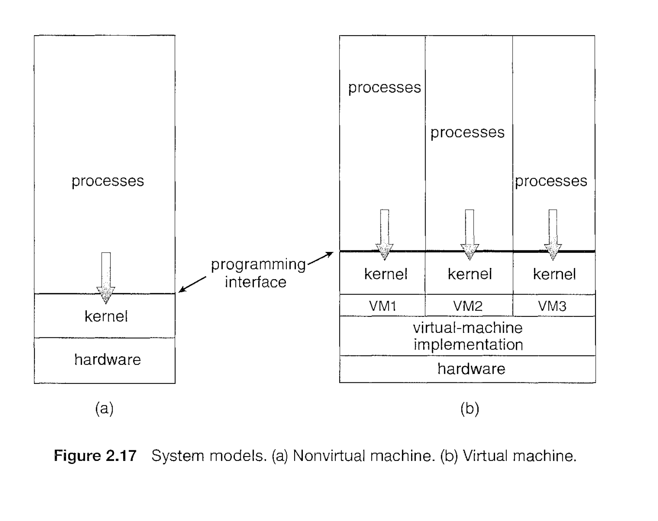
Virtual Machines
Benefits
  Virtual Machines give security, flexibility, and efficiency → they’re great for cloud, development, and enterprise workloads.
Simulation
  The VM imitates hardware in software. It reproduces the behavior of an entire hardware platform so that guest OSes can run unmodified, even if they weren’t designed for the host hardware.
Para-virtualization
  The guest OS is modified to be “aware” that it’s running in a virtualized environment.

Slide 41
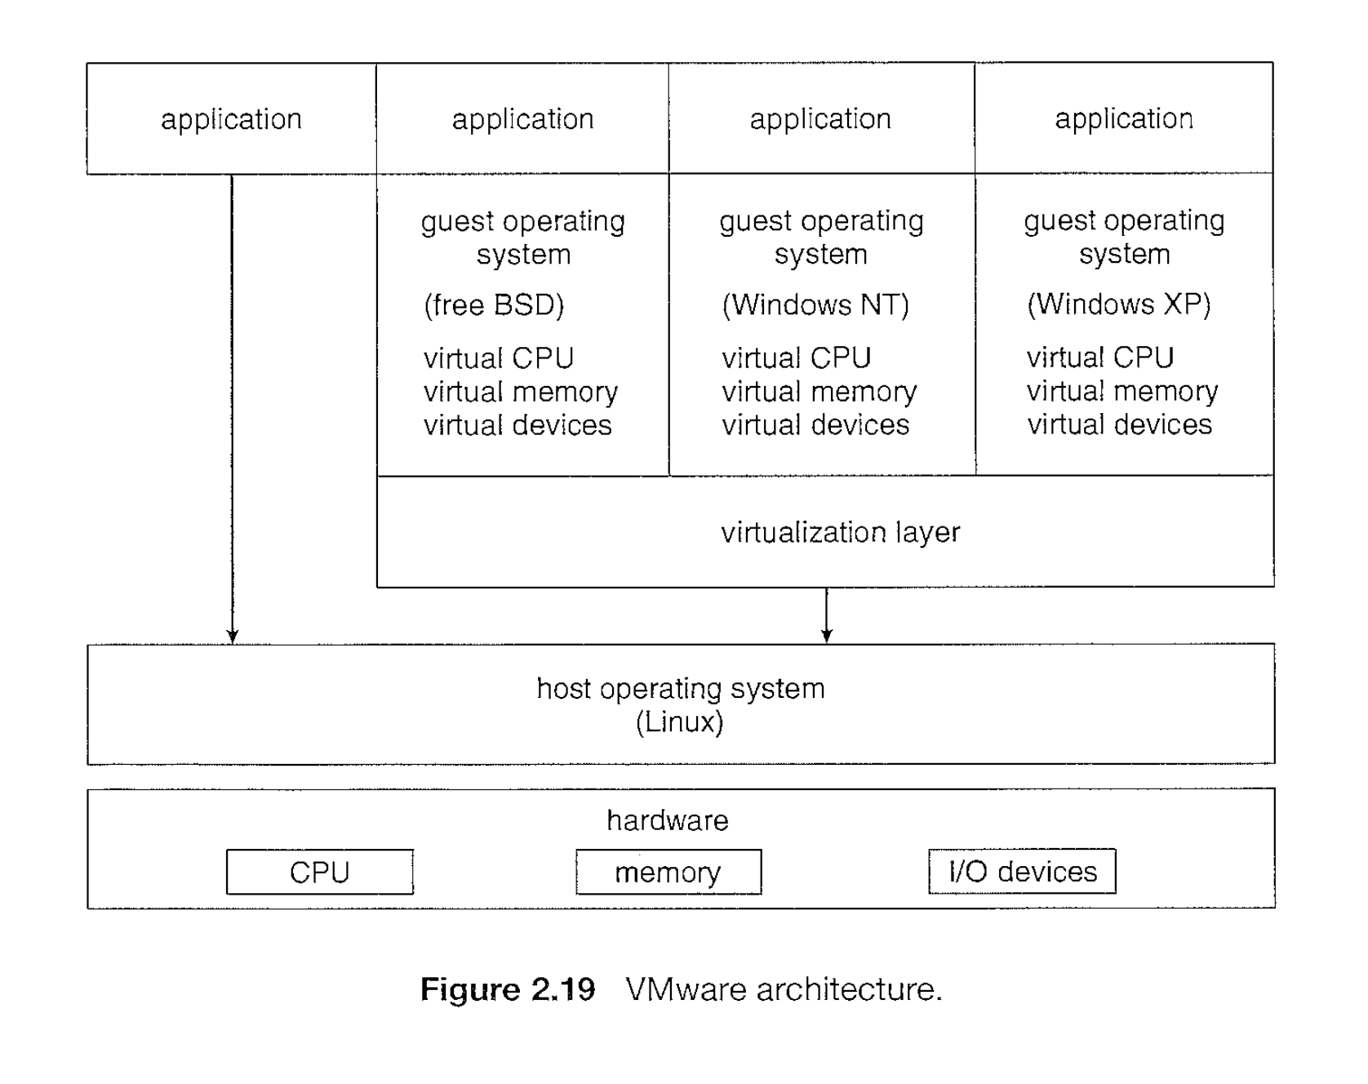
VMware

Slide 42
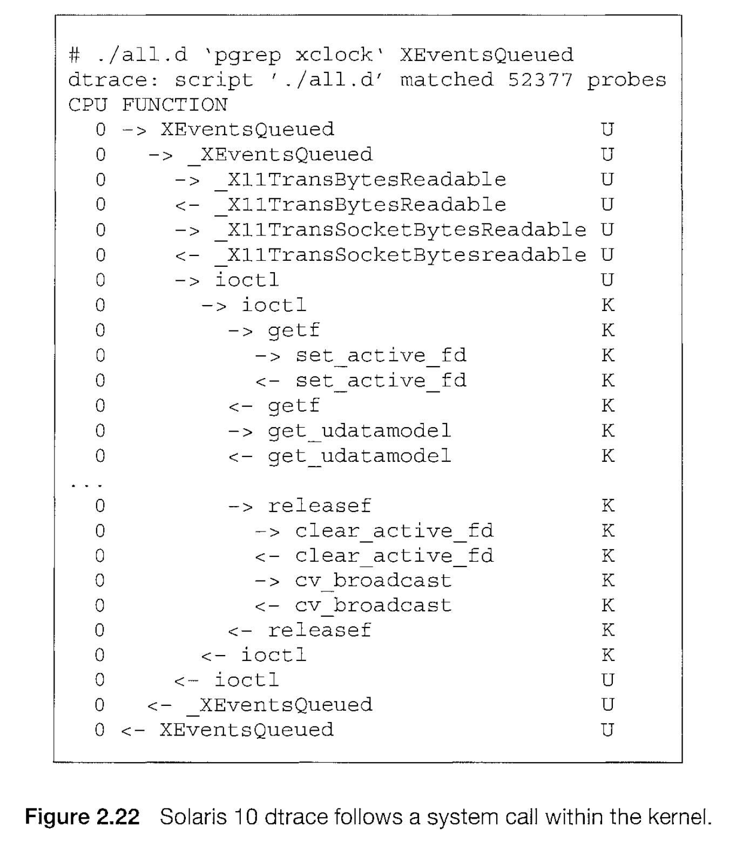
OS debugging
Failure Analysis
Performance Tuning
DTrace
  DTrace lets you observe the inner workings of the OS and applications in real time.
  framework and tool for debugging
Uses of DTrace in OS:
Debugging performance bottlenecks.
Monitoring CPU, memory, file system, or network usage.
Tracing system calls and kernel events.
Observing application behavior without modifying the source code.
Troubleshooting issues in production systems.

